Slide 1
AWS VPC

Slide 2
What is VPC?
A virtual private cloud (VPC) is a virtual network dedicated to your AWS account. It is logically isolated from other virtual networks in the AWS Cloud.
You can specify an IP address range for the VPC, add subnets, add gateways, and associate security groups.
A subnet is a range of IP addresses in your VPC. You launch AWS resources, such as Amazon EC2 instances, into your subnets. You can connect a subnet to the internet, other VPCs, and your own data centers, and route traffic to and from your subnets using route tables.

Slide 3
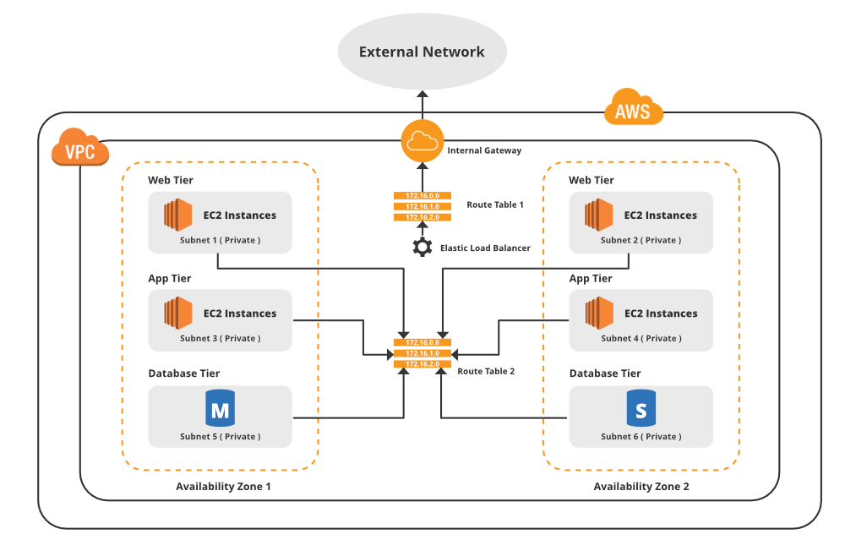

Slide 4
Configuring VPC
Virtual private clouds (VPC) A VPC is a virtual network that closely resembles a traditional network that you'd operate in your own data center. After you create a VPC, you can add subnets.
Subnets- A subnet is a range of IP addresses in your VPC. A subnet must reside in a single Availability Zone. After you add subnets, you can deploy AWS resources in your VPC.
IP addressing- You can assign IP addresses, both IPv4 and IPv6, to your VPCs and subnets. You can also bring your public IPv4 and IPv6 GUA addresses to AWS and allocate them to resources in your VPC, such as EC2 instances, NAT gateways, and Network Load Balancers.
Routing- Use route tables to determine where network traffic from your subnet or gateway is directed.
Gateways and endpoints- A gateway connects your VPC to another network. For example, use an internet gateway to connect your VPC to the internet. Use a VPC endpoint to connect to AWS services privately, without the use of an internet gateway or NAT device.

Slide 5
Configuring VPC
Peering connections- Use a VPC peering connection to route traffic between the resources in two VPCs.
Traffic Mirroring- Copy network traffic from network interfaces and send it to security and monitoring appliances for deep packet inspection.
Transit gateways- Use a transit gateway, which acts as a central hub, to route traffic between your VPCs, VPN connections, and AWS Direct Connect connections.
VPC Flow Logs- A flow log captures information about the IP traffic going to and from network interfaces in your VPC.
VPN connections- Connect your VPCs to your on-premises networks using AWS Virtual Private Network (AWS VPN).

Slide 6
Public vs Private IPv4
The Internet Assigned Numbers Authority (IANA) established certain
blocks of IPv4 addresses for the use of private (LAN) and public
(Internet) addresses
Private IP can only allow certain values:
• 10.0.0.0 – 10.255.255.255 (10.0.0.0/8) in big networks
• 172.16.0.0 – 172.31.255.255 (172.16.0.0/12) AWS default VPC in that range
• 192.168.0.0 – 192.168.255.255 (192.168.0.0/16) e.g., home networks
All the rest of the IP addresses on the Internet are Public

Slide 7
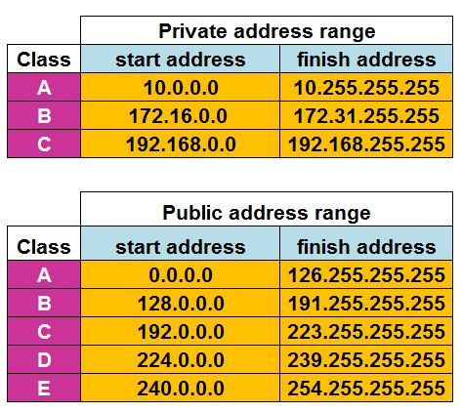
Public vs Private IPv4
The crucial difference between a public and private IP address is that the public IP can be seen by other devices on the Internet, while the private IP cannot.
Therefore, public IPs are used to interact and communicate online, while private IPs operate within a local network.

Slide 8
CIDR
• Classless Inter-Domain Routing – a method for allocating IP addresses
• Used in Security Groups rules and AWS networking in general
When you create a VPC, you must specify an IPv4 CIDR block for the VPC. The allowed block size is between a /16 netmask (65,536 IP addresses) and /28 netmask (16 IP addresses).
After you've created your VPC, you can associate additional IPv4 CIDR blocks with the VPC.

Slide 9
CIDR
A CIDR consists of two components
Base IP
• Represents an IP contained in the range (XX.XX.XX.XX)
• Example: 10.0.0.0, 192.168.0.0, …
Subnet Mask
Defines how many bits can change in the IP. Example: /0, /24, /32
Can take two forms:
• /8 ⬄ 255.0.0.0
• /16 ⬄ 255.255.0.0
• /24 ⬄ 255.255.255.0
• /32 ⬄ 255.255.255.255

Slide 10
Default VPC
All new AWS accounts have a default VPC
• New EC2 instances are launched into the default VPC if no subnet is specified
• Default VPC has Internet connectivity and all EC2 instances inside it have public IPv4 addresses
• We also get a public and a private IPv4 DNS names

Slide 11
VPC in AWS
• You can have multiple VPCs in an AWS region (max. 5 per region – soft limit)
• Max. CIDR per VPC is 5, for each CIDR:
• Min. size is /28 (16 IP addresses)
• Max. size is /16 (65536 IP addresses)
• Because VPC is private, only the Private IPv4 ranges are allowed:
• 10.0.0.0 – 10.255.255.255 (10.0.0.0/8)
• 172.16.0.0 – 172.31.255.255 (172.16.0.0/12)
• 192.168.0.0 – 192.168.255.255 (192.168.0.0/16)
Your VPC CIDR should NOT overlap with your other networks (e.g., corporate)

Slide 12
Subnets
• AWS reserves 5 IP addresses (first 4 & last 1) in each subnet
• These 5 IP addresses are not available for use and can’t be assigned to an EC2 instance
Example: if CIDR block 10.0.0.0/24, then reserved IP addresses are:
• 10.0.0.0 – Network Address
• 10.0.0.1 – reserved by AWS for the VPC router
• 10.0.0.2 – reserved by AWS for mapping to Amazon-provided DNS
• 10.0.0.3 – reserved by AWS for future use
• 10.0.0.255 – Network Broadcast Address. AWS does not support broadcast in a VPC, therefore the address is reserved
Exam Tip, if you need 29 IP addresses for EC2 instances:
• You can’t choose a subnet of size /27 (32 IP addresses, 32 – 5 = 27 < 29)
• You need to choose a subnet of size /26 (64 IP addresses, 64 – 5 = 59 > 29)

Slide 13
Internet Gateway (IGW)
• IGW Allows resources (e.g., EC2 instances) in a VPC connect to the Internet
• It scales horizontally and is highly available and redundant
• Must be created separately from a VPC
• One VPC can only be attached to one IGW and vice versa
• Internet Gateways on their own do not allow Internet access…
• Route tables must also be edited!

Slide 14
Bastion Host
• We can use a Bastion Host to SSH into our private EC2 instances
• The bastion is in the public subnet which is then connected to all other private subnets
• Bastion Host security group must allow inbound from the internet on port 22 from restricted CIDR, for example the public CIDR of your corporation
• Security Group of the EC2 Instances must allow the Security Group of the Bastion Host, or the private IP of the Bastion host

Slide 15
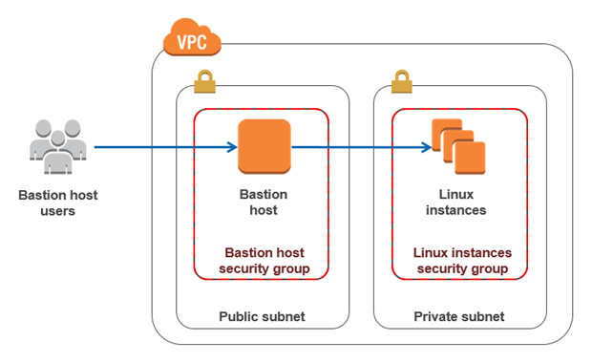

Slide 16
NAT Instance
NAT = Network Address Translation
• Allows EC2 instances in private subnets to connect to the Internet
• Must be launched in a public subnet
• Must disable EC2 setting: Source /destination Check
• Must have Elastic IP attached to it
• Route Tables must be configured to route traffic from private subnets to the NAT Instance

Slide 17
NAT Gateway
• AWS-managed NAT, higher bandwidth, high availability, no administration
• Pay per hour for usage and bandwidth
• NATGW is created in a specific Availability Zone, uses an Elastic IP
• Can’t be used by EC2 instance in the same subnet (only from other
subnets)
• Requires an IGW (Private Subnet => NATGW => IGW)
• 5 Gbps of bandwidth with automatic scaling up to 45 Gbps
• No Security Groups to manage / required

Slide 18
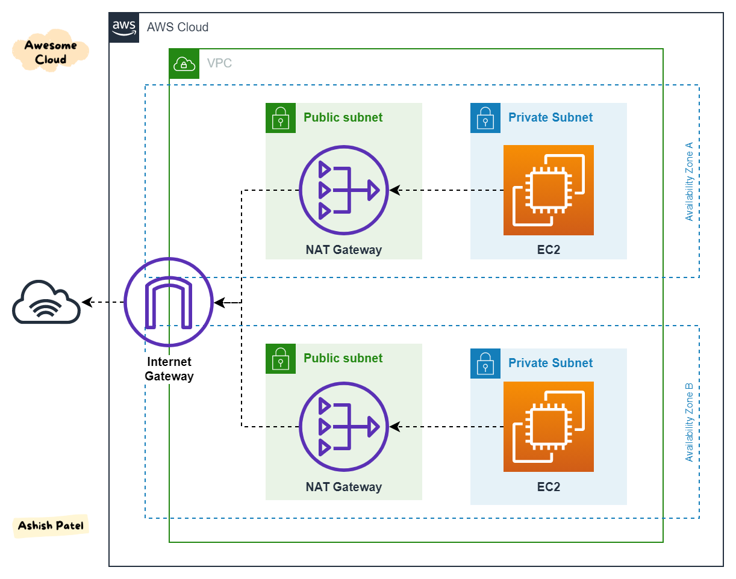

Slide 19
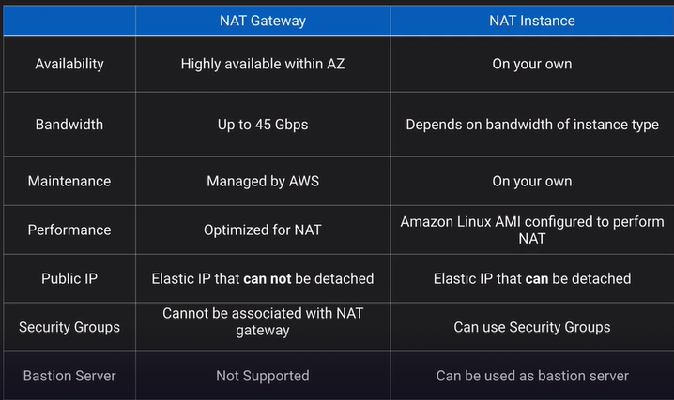

Slide 20
NACL- Network Access Control List
• NACL are like a firewall which control traffic from and to subnets
• One NACL per subnet, new subnets are assigned the Default NACL
You define NACL Rules:
• Rules have a number (1-32766), higher precedence with a lower number
• First rule match will drive the decision
• Example: if you define #100 ALLOW 10.0.0.10/32 and #200 DENY 10.0.0.10/32, the IP
address will be allowed because 100 has a higher precedence over 200
• The last rule is an asterisk (*) and denies a request in case of no rule match
• AWS recommends adding rules by increment of 100
• Newly created NACLs will deny everything
• NACL are a great way of blocking a specific IP address at the subnet level

Slide 21
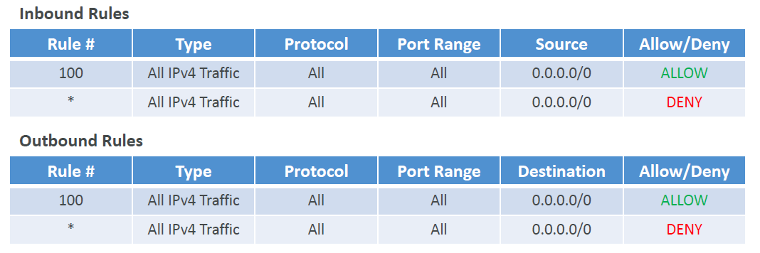
Default NACL
• Accepts everything inbound/outbound with the subnets it’s associated with
• Do NOT modify the Default NACL, instead create custom NACLs

Slide 22
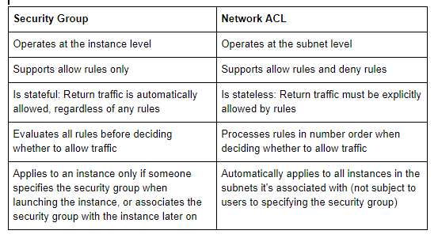

Slide 23
VPC Peering
• Privately connect two VPCs using AWS’ network
• Make them behave as if they were in the same network
• Must not have overlapping CIDRs
• VPC Peering connection is NOT transitive (must be established for each VPC that need to communicate with one another)
• You must update route tables in each VPC’s subnets to ensure EC2 instances can communicate with each other
• You can create VPC Peering connection between VPCs in different AWS accounts/regions
• You can reference a security group in a peered VPC (works cross
accounts – same region)

Slide 24
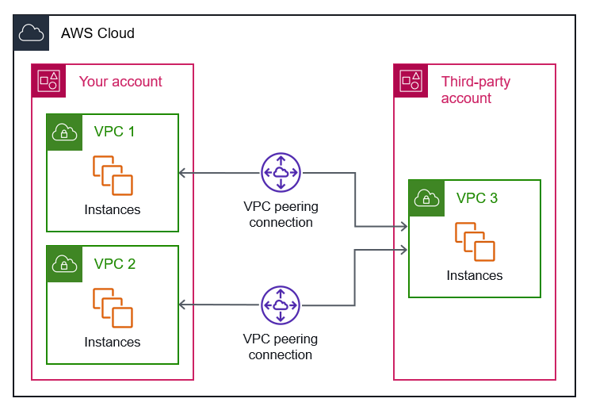

Slide 25
VPC Endpoints (AWS Private Link)
• Every AWS service is publicly exposed (public URL)
• VPC Endpoints (powered by AWS PrivateLink) allows you to connect to AWS services using a private network instead of using the public Internet
• They’re redundant and scale horizontally
• They remove the need of IGW, NATGW, etc to access AWS Services
In case of issues:
• Check DNS Setting Resolution in your VPC
• Check Route Tables

Slide 26
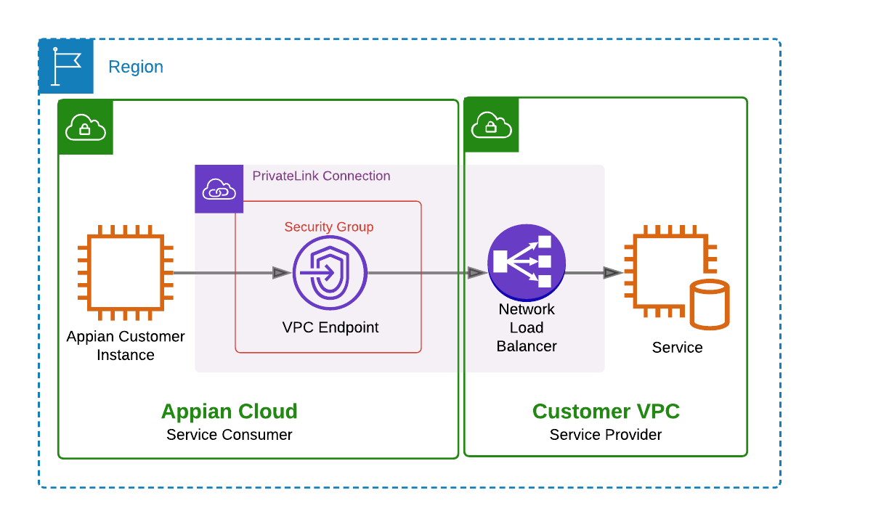

Slide 27
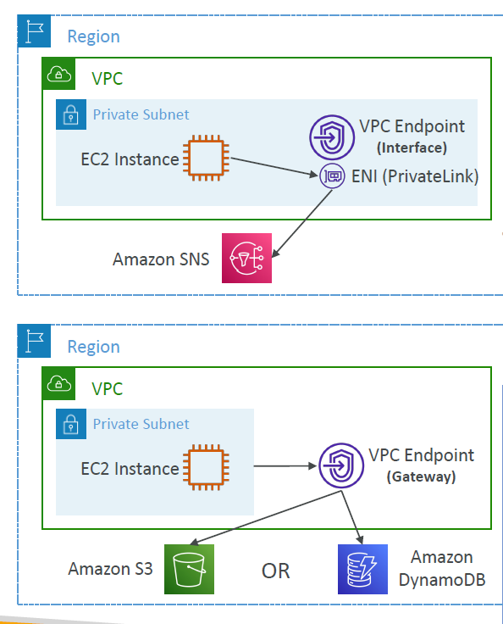
Types of Endpoints
Interface Endpoints (powered by PrivateLink)
• Provisions an ENI (private IP address) as an entry point (must attach a Security Group)
• Supports most AWS services
• $ per hour + $ per GB of data processed
Gateway Endpoints
• Provisions a gateway and must be used as a target in a route table (does not use security groups)
• Supports both S3 and DynamoDB
• Free

Slide 28
VPC flow Logs
Capture information about IP traffic going into your interfaces:
• VPC Flow Logs
• Subnet Flow Logs
• Elastic Network Interface (ENI) Flow Logs
• Helps to monitor & troubleshoot connectivity issues
• Flow logs data can go to S3, CloudWatch Logs, and Kinesis Data Firehose
• Captures network information from AWS managed interfaces too: ELB,
RDS, ElastiCache, Redshift, WorkSpaces, NATGW, Transit Gateway…

Slide 29
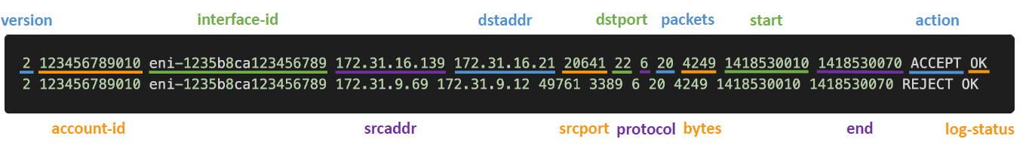
VPC Flow Logs Syntax
• srcaddr & dstaddr – help identify problematic IP
• srcport & dstport – help identity problematic ports
• Action – success or failure of the request due to Security Group / NACL
• Can be used for analytics on usage patterns, or malicious behavior
• Query VPC flow logs using Athena on S3 or CloudWatch Logs Insights

Slide 30
AWS Site-to-Site VPN
Virtual Private Gateway (VGW)
• VPN concentrator on the AWS side of the VPN connection
• VGW is created and attached to the VPC from which you want to create the Site-to-Site VPN connection
• Possibility to customize the ASN (Autonomous System Number)
Customer Gateway (CGW)
• Software application or physical device on customer side of the VPN connection

Slide 31
Direct Connect (DX)
• Provides a dedicated private connection from a remote network to your VPC
• Dedicated connection must be setup between your DC and AWS Direct
Connect locations
• You need to setup a Virtual Private Gateway on your VPC
• Access public resources (S3) and private (EC2) on same connection
• Use Cases:
• Increase bandwidth throughput - working with large data sets – lower cost
• More consistent network experience - applications using real-time data feeds
• Hybrid Environments (on prem + cloud)
• Supports both IPv4 and IPv6

Slide 32
Direct Connect – Connection Types
Dedicated Connections: 1Gbps,10 Gbps and 100 Gbps capacity
• Physical ethernet port dedicated to a customer
• Request made to AWS first, then completed by AWS Direct Connect Partners
Hosted Connections: 50Mbps, 500 Mbps, to 10 Gbps
• Connection requests are made via AWS Direct Connect Partners
• Capacity can be added or removed on demand
• 1, 2, 5, 10 Gbps available at select AWS Direct Connect Partners
• Lead times are often longer than 1 month to establish a new connection

Slide 33
Transit Gateway
• For having transitive peering between thousands of VPC and
on-premises, hub-and-spoke (star) connection
• Regional resource, can work cross-region
• Share cross-account using Resource Access Manager (RAM)
• You can peer Transit Gateways across regions
• Route Tables: limit which VPC can talk with other VPC
• Works with Direct Connect Gateway, VPN connections
• Supports IP Multicast (not supported by any other AWS
service)

Slide 34
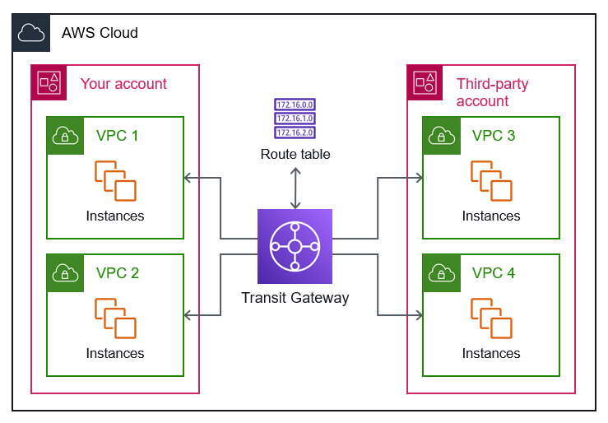

Slide 35
Traffic Mirroring
• Allows you to capture and inspect network traffic in your VPC
• Route the traffic to security appliances that you manage
Capture the traffic
• From (Source) – ENIs
• To (Targets) – an ENI or a Network Load Balancer
• Capture all packets or capture the packets of your interest (optionally, truncate packets)
• Source and Target can be in the same VPC or different VPCs (VPC Peering)
• Use cases: content inspection, threat

Slide 36
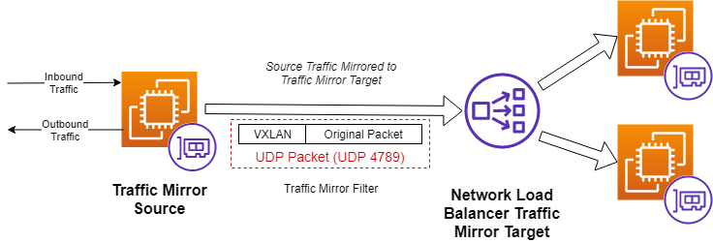

Slide 37
IPv6
• IPv4 designed to provide 4.3 Billion addresses (they’ll be exhausted soon)
• IPv6 is the successor of IPv4
• IPv6 is designed to provide 3.4 × 10+, unique IP addresses
• Every IPv6 address is public and Internet-routable (no private range)
• Format -> x.x.x.x.x.x.x.x (x is hexadecimal, range can be from 0000 to ffff)
• Examples:
• 2001:db8:3333:4444:5555:6666:7777:8888
• 2001:db8:3333:4444:cccc:dddd:eeee:ffff
• :: -> all 8 segments are zero
• 2001:db8:: -> the last 6 segments are zero
• ::1234:5678 -> the first 6 segments are zero
• 2001:db8::1234:5678 -> the middle 4 segments are zero

Slide 38
• IPv4 cannot be disabled for your VPC and subnets
• You can enable IPv6 (they’re public IP addresses) to operate in dual-stack mode
• Your EC2 instances will get at least a private internal IPv4 and a public IPv6
• They can communicate using either IPv4 or IPv6 to the internet through an Internet Gateway
• So, if you cannot launch an EC2 instance in your subnet
• It’s not because it cannot acquire an IPv6 (the space is very large)
• It’s because there are no available IPv4 in your subnet
• Solution: create a new IPv4 CIDR in your subnet

Slide 39
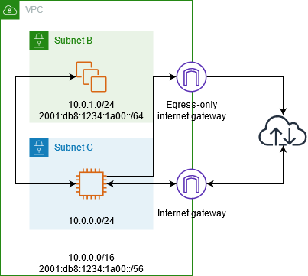
Egress-only Internet Gateway
• Used for IPv6 only
• (similar to a NAT Gateway but for IPv6)
• Allows instances in your VPC outbound
connections over IPv6 while preventing
the internet to initiate an IPv6 connection
to your instances
• You must update the Route Tables

